Slide 1
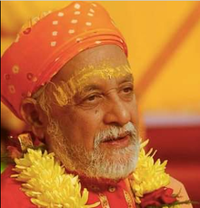
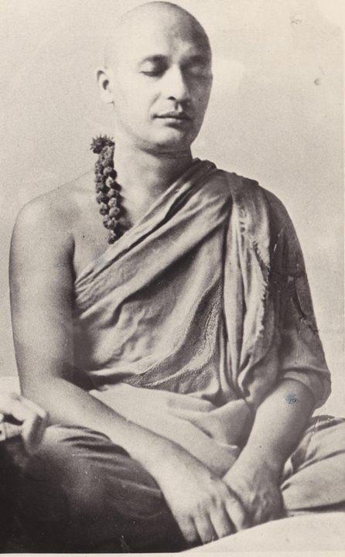
Swami Satyananda Saraswati

Slide 2
Satyananda Saraswati (25 December 1923 – 5 December 2009), was a Sanyasi, yoga teacher and guru in both his native India and the West. He was a student of Sivananda Saraswati, the founder of the Divine Life Society, and founded the Bihar School of Yoga in 1964. He wrote over 80 books, including the popular 1969 manual Asana Pranayama Mudra Bandha.

Slide 3
Biography
Sri Swami Satyananda Saraswati was born in 1923 at Almora (Uttaranchal) into a family of farmers and kshatriyas, the warrior caste.It is claimed that he was classically educated and studied Sanskrit, the Vedas and the Upanishads. His ancestors were warriors and many of his kith and kin, including his father, served in the army and police force. However, from an early age it became evident that Sri Swamiji had a different destiny, as he began to have spiritual experiences at the age of six. During his early childhood many saints and sadhus blessed him, including Anandamayi Ma, and foretold that he would have a very developed awareness.
He stated that he began to have spiritual experiences at the age of six, when his awareness spontaneously left the body and he saw himself lying motionless on the floor. This experience of disembodied awareness continued, leading him to saints of that time such as Anandamayi Ma.

Slide 4
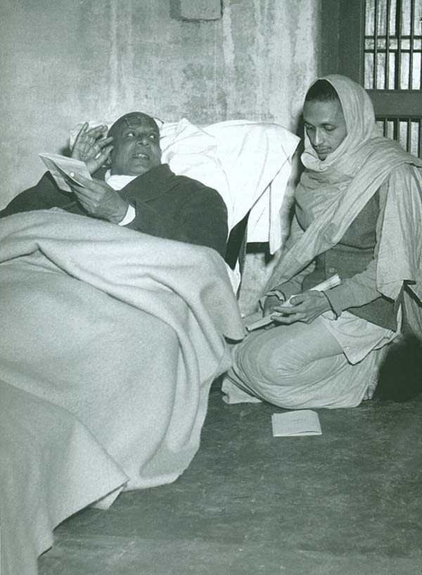
Spiritual Initiation
At age eighteen, he left his home to seek a spiritual master. In 1943, at the age of twenty, he met his guru Sivananda Saraswati and went to live at Sivananda's ashram in Rishikesh.Sivananda initiated him into the Dashnam Order of Sannyasa on 12 September 1947 on the banks of the Ganges, and gave him the name of Swami Satyananda Saraswati. He stayed with Sivananda for a further nine years but received little further formal instruction from him.
He claimed to have met a tantric bhairavi, Sukhman Giri, who gave him shaktipat and directed him to find a guru to stabilise his spiritual experiences. he stated that he would become unconscious during meditation and that "One day I met a mahatma, a great saint, who was passing by my birthplace...So he told me I should find a guru

Slide 5
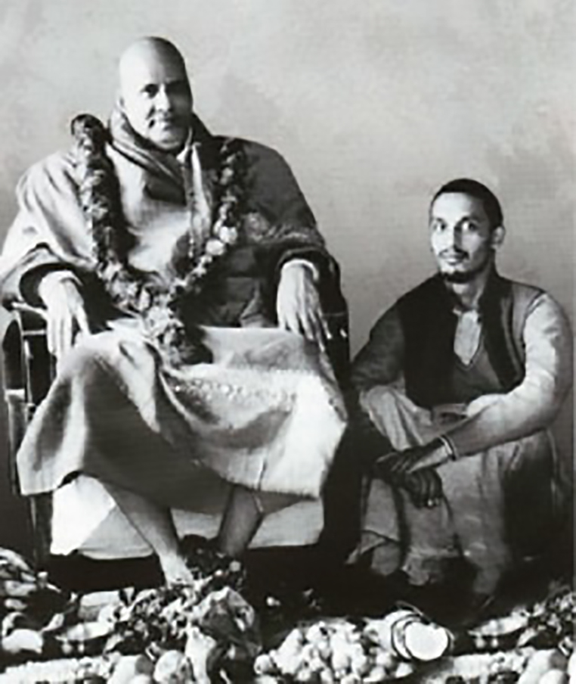
In those early years at Rishikesh, Sri Swami Satyananda Saraswati immersed himself in guru seva. At that time the ashram was still in its infancy and even the basic amenities such as buildings and toilets were absent. The forests surrounding the small ashram were infested with snakes, scorpions, mosquitoes, monkeys and even tigers. The ashram work was arduous and difficult, requiring Sri Swamiji to work long hours in the various departments of the nascent ashram.

Slide 6
Of that glorious time when he lived and served his guru, Sri Swamiji says that it was a period of total communion and surrender to the guru tattwa, whereby he felt that just to hear, speak of or see Sri Swami Sivananda Saraswati was yoga. Through his nishkama seva he gained an enlightened understanding of the secrets of spiritual life and became an authority on yoga, tantra, Vedanta, Samkhya and kundalini yoga. Sri Swami Sivananda said of Swami Satyananda, “Few would exhibit such intense vairagya at such an early age. Swami Satyananda is full of the Nachiketa element.”

Slide 7
Sri Swami Satyananda Saraswati’s knowledge unfolded from within through his untiring seva as well as his abiding faith and love for Sri Swami Sivananda Saraswati, who told him, “Work hard and you will be purified. You do not have to search for the light; the light will unfold from within you.” In 1956, Sri Swami Sivananda Saraswati taught him kriya yoga and gave him the mandate and mission to “spread yoga from door to door and shore to shore”.
Sri Swami Satyananda Saraswati set out as a wandering sannyasin and travelled extensively by foot, car, train and sometimes even by camel and elephants throughout India, Afghanistan, Burma, Nepal, Tibet, Ceylon and the entire Asian subcontinent. During his travels, he met people from all strata of society and began formulating his ideas on how to propagate the science of yoga.

Slide 8
From 1963 to 1982, Sri Swamiji took yoga to each and every corner of the world, to people of every caste, creed, religion and nationality. He inspired millions of seekers in different countries. One can easily say that Sri Swamiji hoisted the flag of yoga in every nook and cranny of the world. Nowhere did he face opposition, resistance or criticism. His way was unique. Well-versed in all religions and scriptures, he incorporated their wisdom with such a natural flair that people of all faiths were drawn to him.

Slide 9
Sri Swamiji was a pioneer of yoga as he presented techniques of pratyahara, dharana, dhyana, asana, pranayama, mudra and bandha in such a methodical and simple manner that it became possible for everyone to experience their physical, mental, emotional and spiritual development. Sri Swamiji brought to light the knowledge of tantra, the sublime truths of Vedanta, the Upanishads and Puranas, Buddhism, Jainism, Sikhism, Zoroastrianism, Islam and Christianity, including a modern scientific analysis of matter and creation. From the ancient scriptures he interpreted, explained and revealed practices hitherto unknown.

Slide 10
Contribution
In 1956, Sivananda sent Satyananda away to spread his teachings. Basing himself in Munger, Bihar, Satyananda wandered as a mendicant through India, extending his knowledge of spiritual practices and spending some time in seclusion.
In 1962, Satyananda established the International Yoga Fellowship Movement in Rajnandgaon.This inspired the establishment of ashrams and yoga centres spiritually guided by Swami Satyananda in India and around the world.
Bihar School of Yoga: In 1964, he founded the Bihar School of Yoga at Munger, with the intention that it would act as a centre of training for future teachers of yoga as well as offer courses on yoga.
Among those who attended courses at the Bihar School of Yoga were students from abroad and students who subsequently emigrated from India. Some of these people in turn invited Satyananda to teach in their own countries. He lectured and taught for the next twenty years, including a tour of Europe, Australia, New Zealand, Japan, Singapore, North America between April and October 1968. The foreign and expatriate students also established new centres of teaching in their respective countries.[
He authored many books on yoga, which are accepted as textbooks in schools and universities throughout the world. These books have been translated into Italian, German, Spanish, Russian, Yugoslavian, Chinese, French, Greek, Iranian and most other prominent languages of the world.

Slide 11
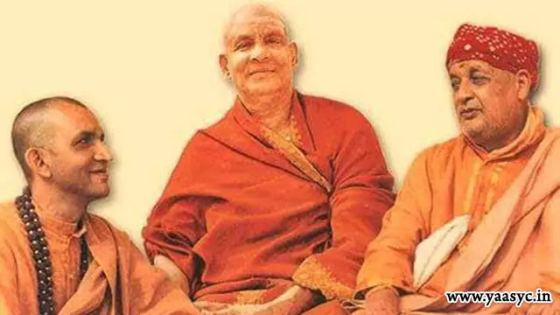
Thus, by 1983, Sri Swami Satyananda’s tireless efforts to spread the message of yoga had touched the whole world. Bihar School of Yoga was well established and recognized throughout the world as a reputed and authentic centre for learning yoga and the spiritual sciences.
At the peak of his accomplishment, Sri Swami Satyananda appointed Swami Niranjanananda as his successor and gave him the mandate to continue the work. Sri Swami Satyananda then gradually withdrew from all activities and in 1988, he left Munger to begin a new phase of his life as a sannyasin.

Slide 12
Rikhiapeeth
Sri Swami Satyananda arrived at Rikhia on 23rd September 1989, at mid-day, the day of vernal equinox, when nature is in perfect balance as the day and night are equal. Soon after, he lit a dhuni or fire and called it Mahakal Chita Dhuni. He began a life of intensive spiritual practice, entering the lifestyle of paramahamsas. In 1991, Sri Swami Satyananda Saraswati received a divine mandate: “Take care of your neighbours as I have taken care of you.” Seeking to strike a balance between the personal aspect of spiritual liberation and the social aspect of helping others, he was guided by a new inspiration: service to and improvement of the living conditions of the tribal people in the thousands of villages surrounding Rikhiadham.
In 1994, in a month-long darshan, Sri Swamiji gave the message of bhakti yoga. He said that the purpose of human life is to realize God through love and to serve God by helping humanity. He prophesied that while hatha yoga and raja yoga were the panacea of the twentieth century, devotion to God and bhakti yoga would be the panacea of the twenty-first.

Slide 13
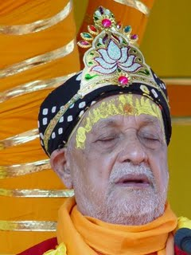
Mahasamadhi
In 2007, Sri Swamiji announced the formation of Rikhiapeeth as an ashram where the three cardinal teachings of Sri Swami Sivananda - serve, love and give - were to be practised and lived. In 2009, after participating in and giving darshan during Sat Chandi Mahayajna and Yoga Poornima where Sri Swamiji inspired everyone to lead the righteous life, he wilfully entered into Mahasamadhi on the midnight of 5th December 2009 and merged into Shiva consciousness.

Slide 14
Publications
In the course of his tireless efforts to fulfill the mandate of his guru and spread the light of yoga to every corner of the globe, Sri Swami Satyananda embarked upon an immense campaign of printing and publishing. In 1963, the first activity of Bihar School of Yoga was the publication of the magazine Yoga in English and Yoga Vidya in Hindi, and this was followed by an unending stream of books on all aspects of the yogic sciences.
Through these publications Sri Swami Satyananda gave to the present and future generations of the world a complete set of yoga practices and guidance on yogic sadhana and lifestyle.
Satyananda wrote over 80 books, including his popular 1969 manual Asana Pranayama Mudra Bandha.
Satyananda's writings have been published by the Bihar School of Yoga and, since 2000, by the Yoga Publications Trust established by his disciple Swami Niranjanananda

Slide 15
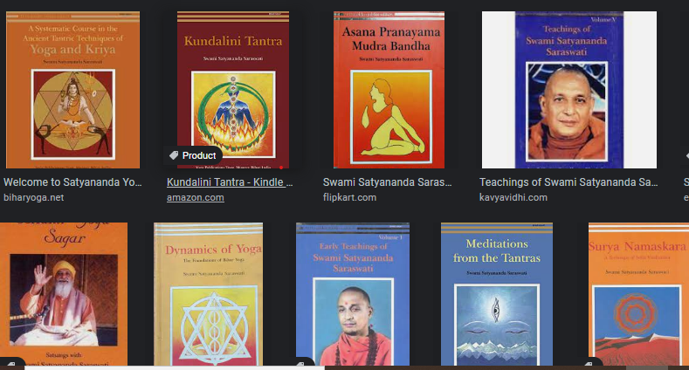

Slide 16



Slide 17
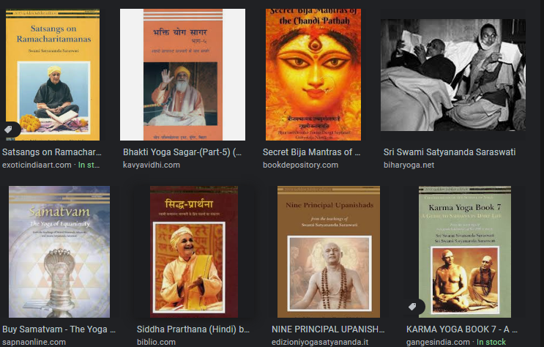

Slide 18
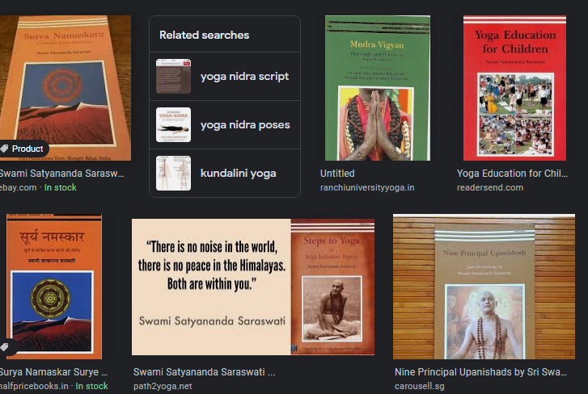

Slide 19
Research
“The science of yoga has great physical and psychological potential. The effect of yoga techniques on human physiology is an inviting field for research for modern physiologists, and scientific investigations into yoga psychology are a challenge for modern psychologists.”
- Sri Swami Satyananda

Slide 20
Sri Swami Satyananda saw the immense potential for, and benefits of, scientific research and experimentation into the effects of yogic techniques, and in the late 1970s he initiated and inspired a range of yogic research projects. This research has provided society with further understanding of how yogic practices affect the human body, mind and emotions, and how the practices can awaken the hidden inner potential and enhance the quality of life.
It has also demonstrated how the various practices and techniques can be used therapeutically to prevent, manage and treat a wide range of conditions, including asthma, hypertension, diabetes, cancer, and also pregnancy. In 1984 at Munger Sri Swami Satyananda founded the Yoga Research Foundation, an institute dedicated to the scientific investigation of yoga practices.

Slide 21
Bihar Yoga / Satyananda Yoga
Sri Swami Satyananda removed the veil of mysticism that had previously shrouded yoga and presented it as a science of personal and spiritual development to aspirants not only in India, but across every continent of the globe. Yoga was revealed in its pure form as a spiritual science for the evolution of consciousness and reached people from all walks and conditions of life, for their physical, mental, emotional and spiritual development.
Under the guidance of Sri Swami Satyananda, the Bihar School of Yoga became the seat of a global yogic renaissance, propagating a blend of yogic practices and principles for cultivating the faculties of head, heart and hands. This system is called the Bihar Yoga or Satyananda Yoga tradition.

Slide 22
Integral Approach
One of the key hallmarks of Bihar Yoga/Satyananda Yoga is the integration of all aspects of yoga. The various branches of yoga are incorporated into a systematic approach to achieve a balanced evolution and wholeness. The foundations of an integral yoga sadhana are formed by the fundamental yogas to develop the faculties of head, heart and hands: hatha yoga, raja yoga, jnana yoga, bhakti yoga and karma yoga. Other branches of yoga also form part of the Bihar Yoga/Satyananda Yoga system, including mantra yoga, nada yoga, kriya yoga, kundalini yoga, laya yoga, and so on.

Slide 23
Practices
In developing the system of Bihar Yoga/Satyananda Yoga, Sri Swami Satyananda brought to light the unknown and hidden practices from the ancient yogic and tantric systems. He identified the progressive steps, stages and sequences of the practices and presented the practices in a simple and systematic manner, enabling one and all to delve into this valuable science and reap the benefits. For the first time the practices became accessible to ordinary people in a practical, safe and effective form. Sri Swami Satyananda saw that simple practices are suitable for contemporary people, and that when practised regularly, they give profound and transformative experiences.
Sri Swami Satyananda thoroughly systematized the practices of yoga in an unparalleled manner, and drawing from the ancient scriptures and wisdom he developed numerous techniques that are now practised around the world. To read more about these unique techniques and practices visit the Practices section.

Slide 24
Expansion of Awareness
Awareness lies at the heart of all Bihar Yoga/Satyananda practices and its entire approach. Sri Swami Satyananda emphasized the importance of bringing awareness into all dimensions of every yoga practice – the physical, mental, emotional, energetic, subtle and spiritual. This allows the awareness to gradually expand, so that over time awareness can be brought into all the activities and aspects of life.
Throughout his life Sri Swami Satyananda taught that the expansion and cultivation of awareness should be the aim of life, and that the means is yoga.

Slide 25
Lifestyle
Sri Swami Satyananda saw yoga as a process of continuous transformation of the total personality, which can be achieved in stages by regular and systematic practice and by assimilating and making yoga a part of one’s daily life.
As well as being a set of practices and a philosophy, yoga also becomes a lifestyle, ultimately allowing one to merge with the flow of life and evolution and become a creative participant in the yajna of life.

Slide 26


